Slide 1



Introduction to Computer Graphics Project - 2022/2023
Eduarda Tavares, 98447, LECI

Slide 2


Main ideas
This project features a game where the user controls a cat and explores a maze…
the goal of the game is to rescue all of the lost kittens and then reach the exit!
Made using: basic THREE.js library, OrbitControls, GLTFLoader
(Three.js version 151.3)
Project URL : https://raw.githack.com/eduarda-aires/Purrfect-Escape/main/index.html

Slide 3


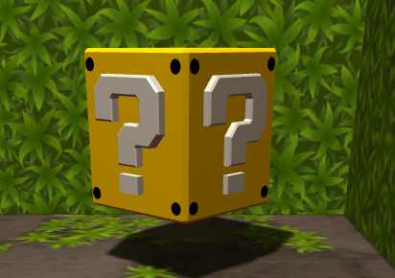
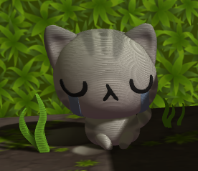

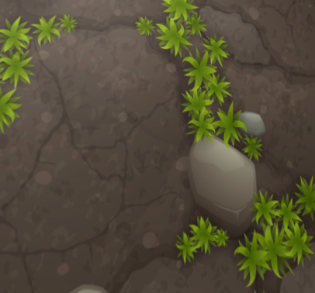
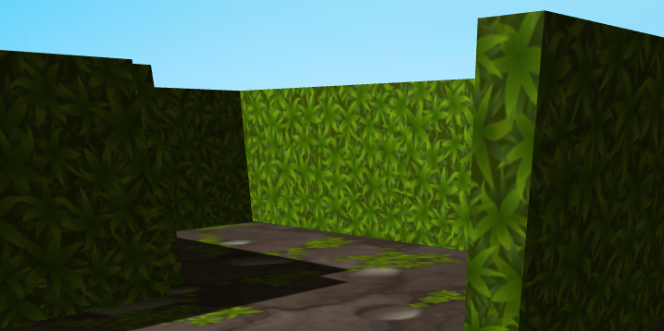
MODELS AND THE Scene graph
Imported Models:
Player’s tuxedo cat;
Orange, brown, gray, white cat models;
Power up (mystery) box.
These models are placed on a plane with a stone texture,
Walls are made from extruded objects with a grass texture.

Slide 4
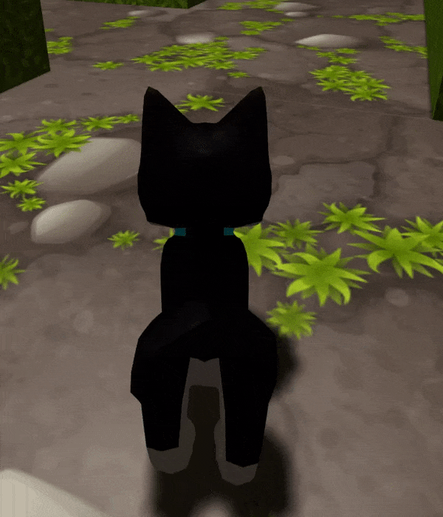
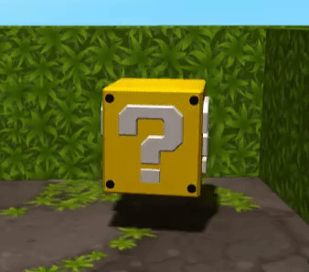
Animation
The player’s cat has an idle and a walking animation, played by an animation mixer.
The mystery boxes rotate on the z axis.

Slide 5
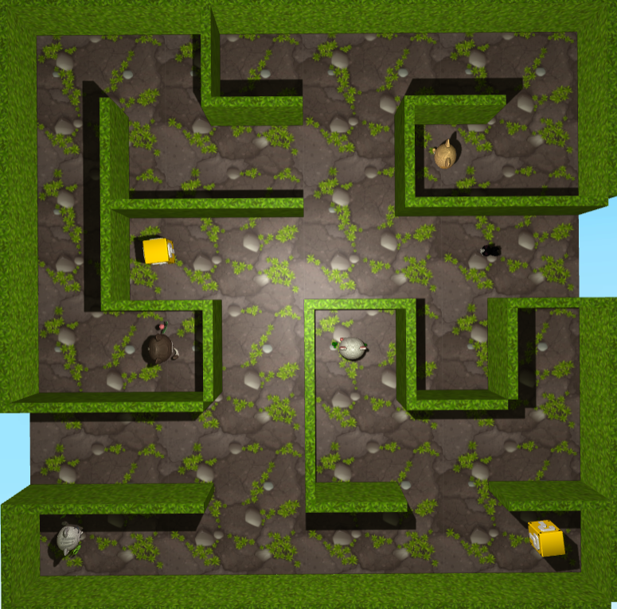
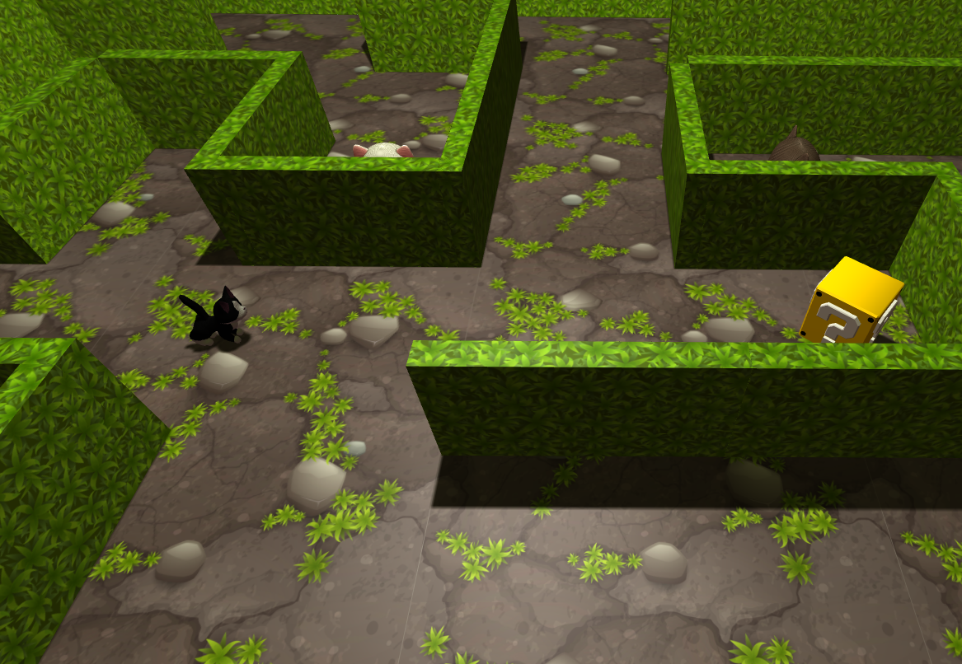
Illumination
There is a white spotlight placed at the top of the scene, facing the ground;
A white ambient light;
A hemispheric light, fading from yellow to crimson.
3 light sources

Slide 6
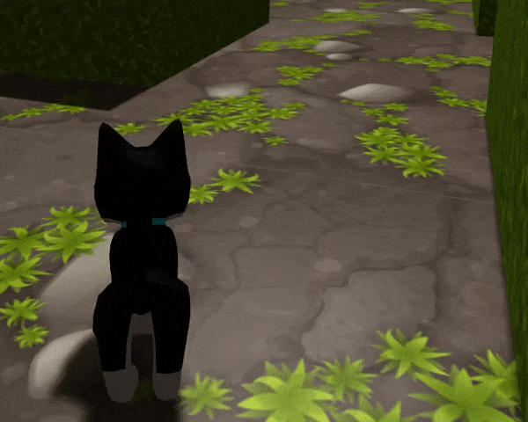
User Interaction
No camera movement through the mouse!
The camera follows the cat. If the cat turns, the camera does as well.
The player can control the cat using the WAD keys:
W to move forward
A to rotate to the left
D to rotate to the right

Slide 7
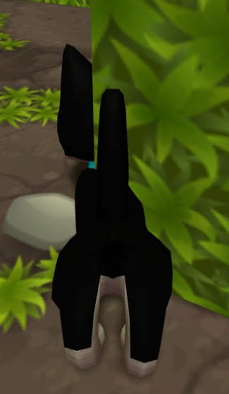
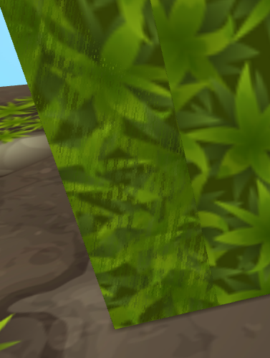
Development
Code was organized in a similar way to the classes…
Initiate empty scene;
Load 3D Objects (Model loading);
Compute frame (Animation).
…divided in three files:
Index (HTML)
Style (CSS)
Scene(JS)
However, there were some problems…
Power-up speed up not working;
Inconsistency with wall collisions;
Flickering textures;
Camera issues.

Slide 8


Conclusions
Although there were some frustrating problems to deal with…
I had fun working on this project and exploring the endless possibilities of THREE.js!

Slide 9
References
SketchFab (https://sketchfab.com/)
Three.js documentation (https://threejs.org/)
GLTF Report (https://gltf.report/)
Freepik (https://br.freepik.com/)
Discover three.js!(https://discoverthreejs.com/)
W3Schools(https://www.w3schools.com/css/)
Files provided in classes

